Slide 1


Dr Akhter’s Monitor Log
Patient Information
Patient Name: Simran Khan
Patient ID: 19023
Location: Khulna, Bangladesh
Time: 12:08 BST
Sensor Readings
Heart Rate: 72 BPM
Average Heart Rate: 75 BPM
Peak Heart Rate: 112 BPM
Lowest Heart Rate: 64 BPM
Temperature: 23°C
Blood Oxygen: 98% SpO2
Air Pressure: 80 PaO2
Humidity: 80% HD

Slide 2
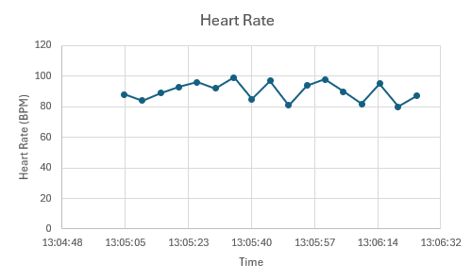
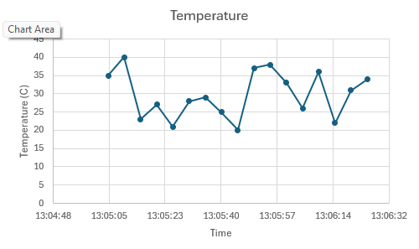
Dr Akhter’s Monitor Log
Patient Information
Patient Name: Simran Khan
Patient ID: 19023
Location: Khulna, Bangladesh
Date: 09/02/2026
Time: 12:08 BST
Sensor Readings
Heart Rate: 72 BPM
Average Heart Rate: 75 BPM
Peak Heart Rate: 112 BPM
Lowest Heart Rate: 64 BPM
Temperature: 23°C
Blood Oxygen: 98% SpO2
Air Pressure: 80 PaO2
Humidity: 80% HD

Slide 3
Could add diagrams of the heart rate, etc

